Slide 1


Continental analysis of Arbovirus transmission dynamics in Africa using genomic and epidemiological data
Preliminary Results
CLIMADE Africa – 14th March 2023
Dr. Houriiyah Tegally, CERI, Stellenbosch University

Slide 2
Questions to Answer
What is the status of surveillance for Arboviruses in Africa in the face of recorded outbreaks?
What are the levels of importations vs endemicity in Africa?
Are the effective population sizes of the relevant pathogens increasing in Africa? (indicates endemic circulation)
What are the risks of importations of Arboviruses from Asia and Americas?
What are the risks of local transmission/outbreaks/epidemics upon importation?
Do transmission dynamics correlate with environmental factors?

Slide 3
Dengue (I to IV) Phylogenetics & Transmission Dynamics in Africa

Slide 4
Dengue (I to IV) outbreaks in Africa from 2017 to 2023 – Countries with top 8 incidence
(Source: https://www.afro.who.int/health-topics/disease-outbreaks/outbreaks-and-other-emergencies-updates)

Slide 5
Dengue (I to IV) outbreaks in Africa from 2017 to 2023 – Countries with top 8 incidence
(Source: https://www.afro.who.int/health-topics/disease-outbreaks/outbreaks-and-other-emergencies-updates)
Cases=17,884 Genomes=44
Cases=1,378 Genomes=3
Cases=4,668 Genomes=20
Cases=5,928 Genomes=114
~20 genomes per 1000 cases
~2 genomes per 1000 cases
~2 genomes per 1000 cases
~4 genomes per 1000 cases
Cases=1,150 Genomes=0
Cases=1,458 Genomes=44
Cases=6,121 Genomes=3
Cases=7,143 Genomes=25
<1 genomes per 1000 cases
~3 genomes per 1000 cases
~30 genomes per 1000 cases

Slide 6
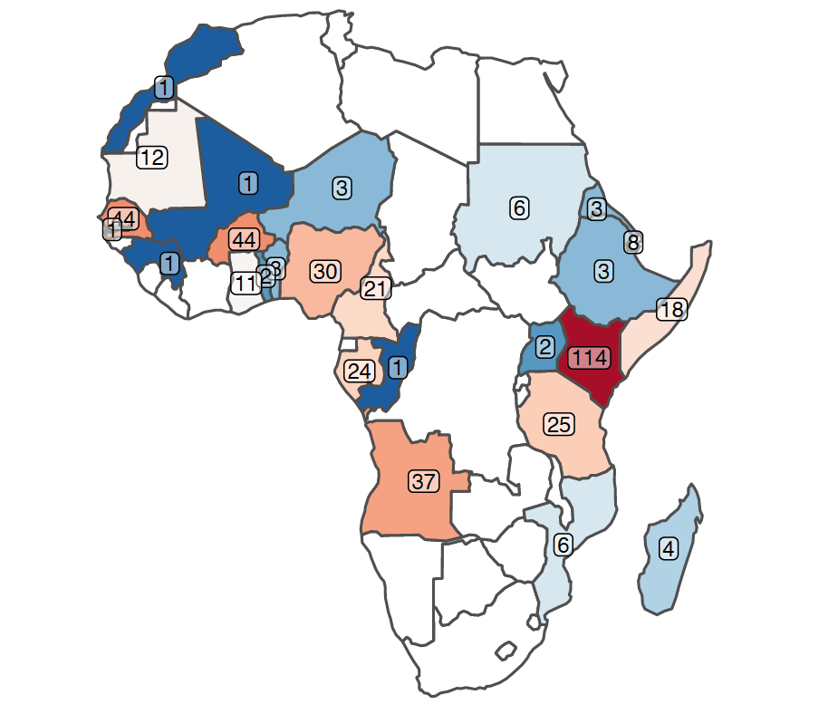
The landscape of genomic surveillance of Dengue (I to IV) in Africa
Dengue
Africa:
genomes = 457
countries = 30
1953-2021
Quality:
Coverage >90% = 215
Genotyped = 208
253 genomes from countries with top 8 incidence in Africa
204 genomes from rest 22 countries

Slide 7
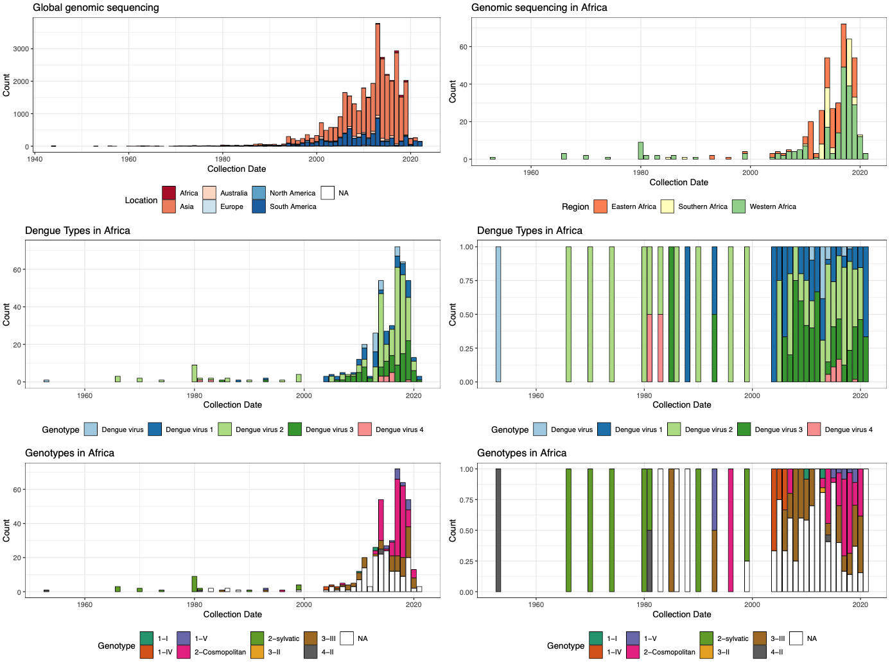
The landscape of genomic surveillance of Dengue (I to IV) in Africa
Dengue
Africa:
genomes = 457
countries = 30
1953-2021
Quality:
Coverage >90% = 215
Genotyped = 208
Global Genomic sequencing:
Genomes > 40,000

Slide 8
Genomes = 457
Quality:
Coverage >90% = 215
Genotyped = 208
The landscape of genomic surveillance of Dengue (I to IV) in Africa

Slide 9
DENV2 Global Phylogeny
DENV2 Transmission Dynamics in Africa
African genomes shown with tippoints
Clades
Other Lineages
Cosmopolitan Lineage
E - Exports from Africa

Slide 10
DENV2 Viral Movement Maps
Focused on Africa

Slide 11
DENV2 Viral Movement Maps
Focused on Africa

Slide 12
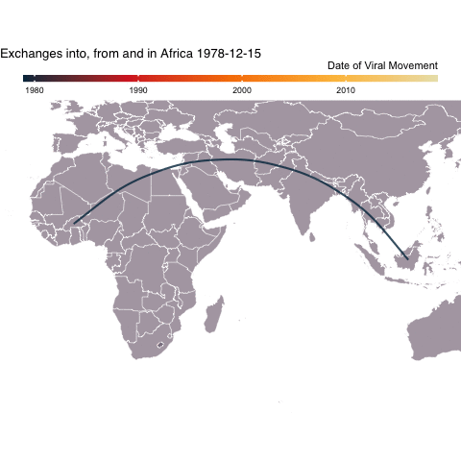
DENV2 Viral Movement Maps
Focused on Africa

Slide 13
DENV3 Global Phylogeny
DENV3 Transmission Dynamics in Africa
African genomes shown with tippoints
E - Exports from Africa

Slide 14
DENV3 Viral Movement Maps
Focused on Africa

Slide 15
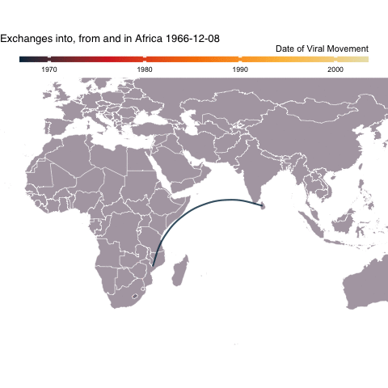
DENV3 Viral Movement Maps
Focused on Africa

Slide 16
DENV4 Global Phylogeny
DENV4 Transmission Dynamics in Africa
African genomes shown with tippoints
E - Exports from Africa

Slide 17
DENV4 Viral Movement Maps
Focused on Africa

Slide 18
DENV1 Global Phylogeny
DENV1 Transmission Dynamics in Africa
African genomes shown with tippoints
E - Exports from Africa

Slide 19
DENV1 Viral Movement Maps
Focused on Africa

Slide 20
Dengue – All Serotypes transmission dynamics
DENV1
DENV2
DENV3
DENV4
E - Exports from Africa
E - Exports from Africa
Genomes <50% coverage
E - Exports from Africa
Genomes <50% coverage
Genomes <50% coverage
E - Exports from Africa
Genomes <50% coverage

Slide 21
Yellow Fever Phylogenetics & Transmission Dynamics in Africa

Slide 22
Yellow Fever outbreaks in Africa

Slide 23
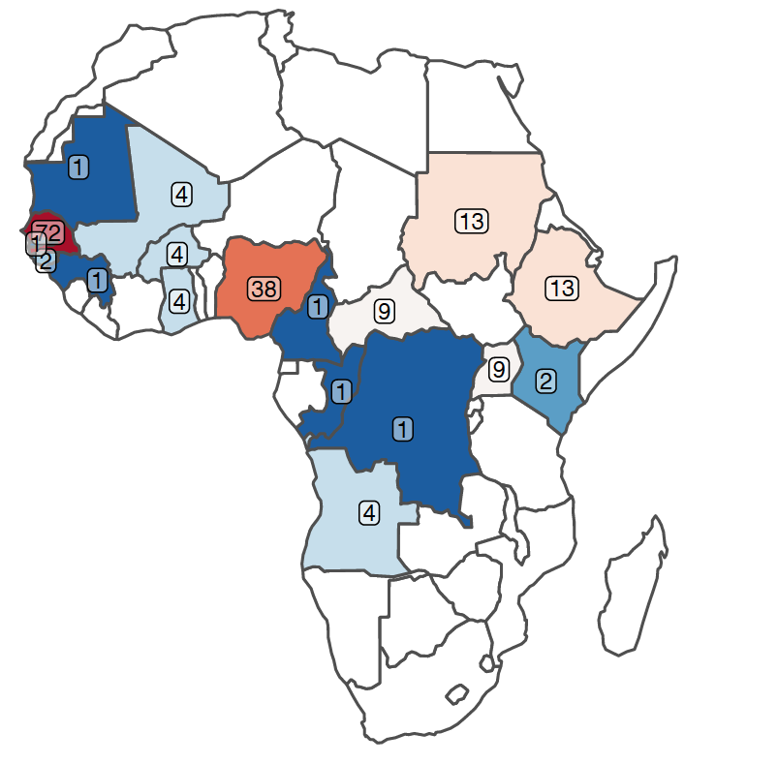
The landscape of genomic surveillance of Yellow Fever in Africa
Yellow Fever
Africa:
genomes = 185
countries = 17
1927-2021
Quality:
Coverage >90% = 64
Genotyped = 177

Slide 24
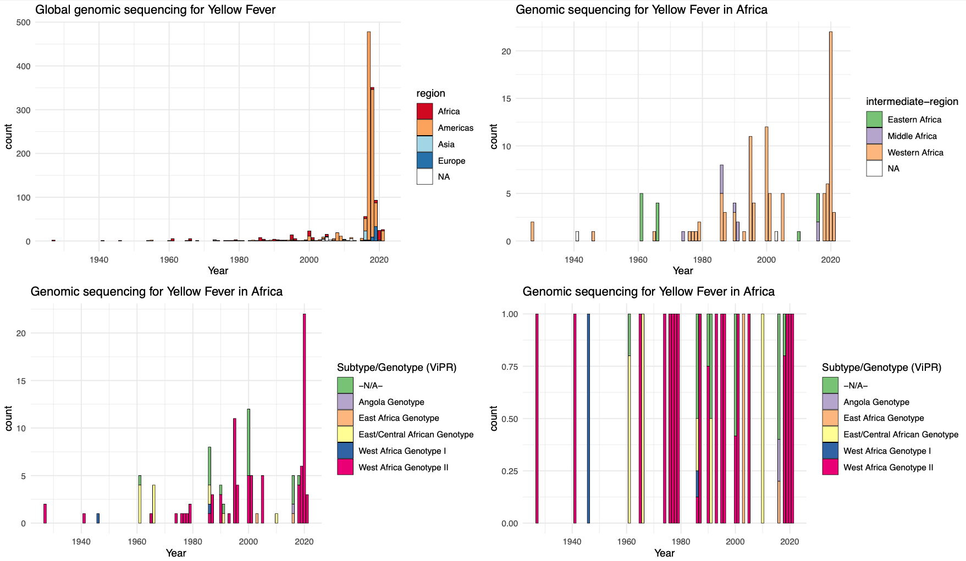
The landscape of genomic surveillance of Yellow Fever in Africa
Yellow Fever
Africa:
genomes = 185
countries = 17
1927-2021
Quality:
Coverage >90% = 64
Genotyped = 177
Global Genomic sequencing:
Genomes = 1823

Slide 25
Yellow Fever Global Phylogeny
African genomes shown with tippoints
Genomes <50% coverage

Slide 26
Yellow Fever Viral Movement Maps
Focused on Africa
>1900s

Slide 27
Next steps
Complete phylogenetics for selected pathogens (Dengue, Chikungunya, Zika, RVF, Yellow Fever, West Nile, CCHF)
Define levels of importations vs endemicity by mapping outbreak info with phylogenetics clusters
Gather and map all seroprevalence studies against outbreak and genomic data to identify gaps
BEAST Phylodynamics in select countries to understand if effective population size is increasing (indicates endemic circulation)
Quantify risk of importations of Arboviruses from Asia and Americas using mobility data and disease susceptibility data
Correlate outbreaks/phylodynamics with environmental info
Gather and map all published estimates of disease susceptibility modelling and correlate with outbreaks
Expand genome database for Arboviruses in Africa!

Slide 28
Acknowledgements
Groups in Africa that have made their genomic data available publicly on Genbank
WHO-AFRO Outbreak Data Curation
Dr. Monika Moir
Dr. James E. San
Yajna Ramphal
Akhil Maharaj

